Slide 1

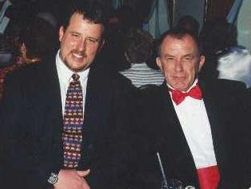
Exposure CS 2021
for CS1
Chapter 1 Section 9-10 Slides
Introduction to Computer Science:
Programming Languages & Networking
PowerPoint Presentation
created by:
Mr. John L. M. Schram
and Mr. Leon Schram
Authors of Exposure
Computer Science

Slide 2
Section 1.9
What is
Programming?

Slide 3
Program Definition
A program is a sequence of instructions that makes a computer perform a desired task.
A programmer is a person who writes a program for a computer.

Slide 4
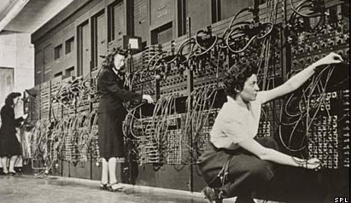
Programming in Machine Code
Programming in Machine Language a.k.a. Machine Code means you are directly manipulating the 1s and 0s of the computer’s binary language.
In some cases, this means
you are manipulating the
wires of the machine.
In other cases, you are flipping switches on and off.
Even if you had the ability to “type” the 1s and 0s, machine language would still be incredibly tedious.

Slide 5
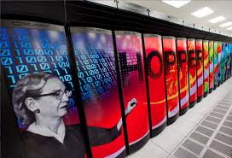
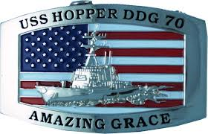
“Amazing Grace”
In the 1940s, Grace Hopper did not like the way we were programming computers. There had to be a better way. The whole reason computers were invented in the first place was to do tedious. It should be possible to program a computer using English words instead of 1s and 0s.
Grace Hopper wrote the first compiler (a type of translator) in 1952 for the language A-0. This paved the way for the other languages that followed. Many of these were also created in part or in whole by Grace Hopper.
Her immeasurable contributions to computer science have earned her the nickname “Amazing Grace”. The Cray XE6 Hopper supercomputer and the USS Hopper Navy destroyer are also named after her.

Slide 6
Types of Languages
Low-Level Languages
Languages that function at, or very close to 1s and 0s.
Powerful, but very difficult.
Examples: Machine Language, Assembly Language
High-Level Languages
Languages that use English-like words as instructions.
Easier, but less powerful.
Examples: BASIC, Pascal, FORTRAN, COBOL, LISP, Java, Python
Very High-Level Languages
Languages that use clickable pictures as instructions.
Example: Lego Mindstorms NXT

Slide 7
Computer Translators
A translator (compiler or interpreter) translates a high-level language into low-level machine code.
A compiler translates the entire program into an executable file before execution.
An interpreter translates one program statement at a time during execution.
Most modern languages use a compiler.

Slide 8
Programming Languages
Year | Language | Purpose / Significance
1957 | FORTRAN | First successful programming language. Designed for mathematicians, scientists and engineers.
1959 | COBOL | Created (largely by Grace Hopper) to handle record processing to make it ideal for the business community.
1964 | BASIC | Designed as a simple, easy-to-learn language to give non-math and non-science majors the ability to use computers.
1967 | Logo | A visual language designed for young children. Introduced Turtle Graphics.
1969 | Pascal | Designed specifically for the purpose of teaching proper programming techniques, as opposed to the quick-and-dirty style of programming in BASIC.
1972 1983 | C C++ | Popular with professional programmers because they combine the readability of high-level languages with the power of low-level languages. These are essentially “medium-level languages”. C++ added Object Oriented Programming.

Slide 9

Programming Languages
Year | Language | Purpose / Significance
1990 | HTML | Created by Tim Berners-Lee along with the 1st web server & the 1st web browser. No he did not “invent the Internet,” but he did invent the Word Wide Web. HTML is the language used by all web browsers. Without it, “surfing the net” wouldn’t be possible.
1994 | Python | A powerful language that was designed to be simple like BASIC, but less “wordy” than Pascal. Uses an interpreter.
1995 | Java | The first Platform Independent computer language. “Platform Independence” means that a program created on one computer will work and have the exact same output on any other computer. Requires the use of OOP.
2006 | Lego NXT | A “very-high level language” where you program with pictures instead of words. An example of NXT is below:

Slide 10

What language will you learn this year?

Slide 11
Section 1.10
Networking

Slide 12
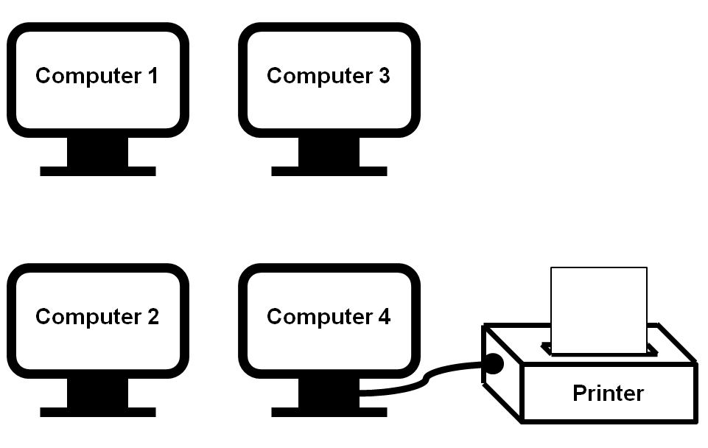
SneakerNet
Early personal computers were not networked at all. Every computer was a stand-alone computer. Some computers were hooked up to printers and many others were not. If you needed to print something, and you were not directly
connected to
a printer, you
saved your work
to a floppy disk,
put on your
sneakers, and
walked to the
printing computer.
Sharing files was
done in the same
way.

Slide 13
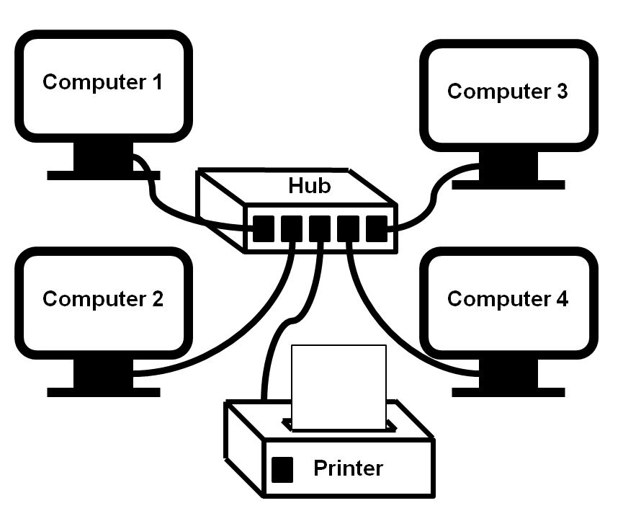
Peer-To-Peer Networks
The 1st practical networks for personal computers were peer-to-peer networks. These are small groups of computers with a common purpose all connected to each other. These types of networks were frequently called Local Area Networks or LANs.
The term “peer-to-peer
network” means every
computer on the network
is equal. In other words,
there is no single computer
controlling the others.
This type of network does
not work well when you
have more than 10
computers.

Slide 14
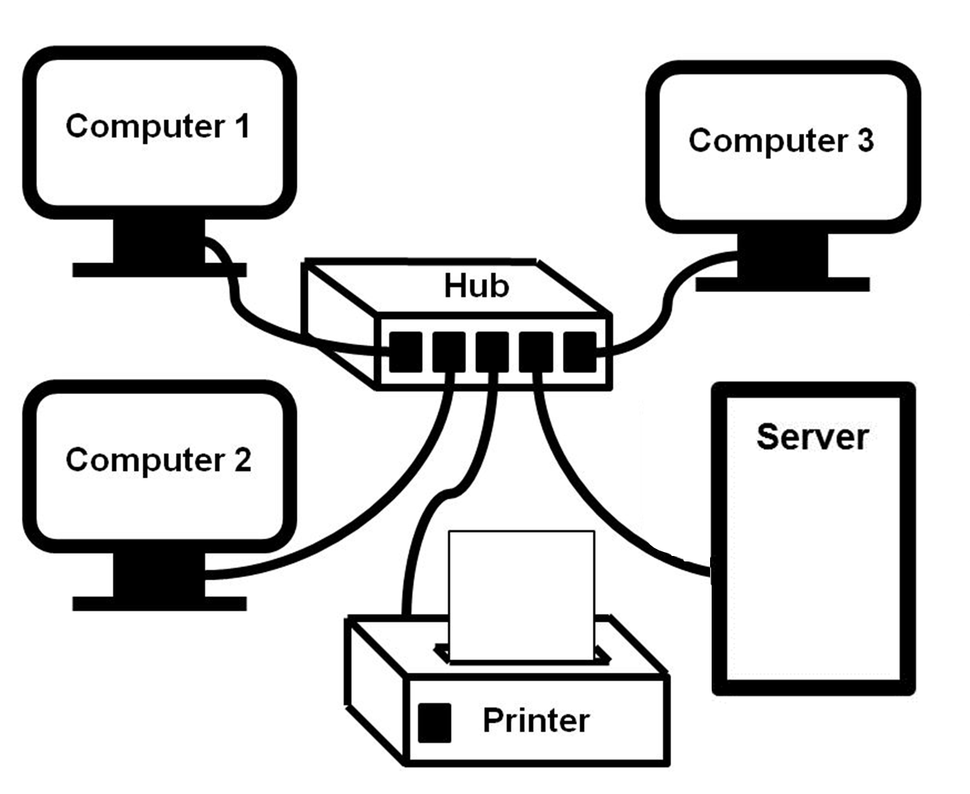
Client-Server Networks
A server is a special computer that is connected to the LAN for one or more purposes. It services the other computers in the network which
are called clients.
Servers can be
used for printing,
login
authentication,
permanent data
storage and
communication.
Server

Slide 15
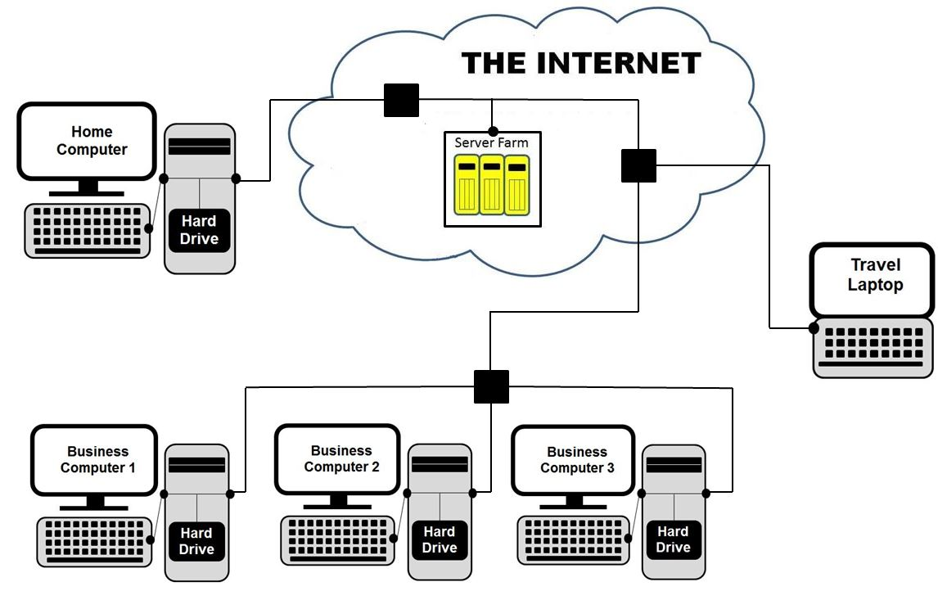
THE INTERNET
Home
Computer
Server Farm
Travel
Laptop
Business
Computer 1
Business
Computer 2
Business
Computer 3

Slide 16
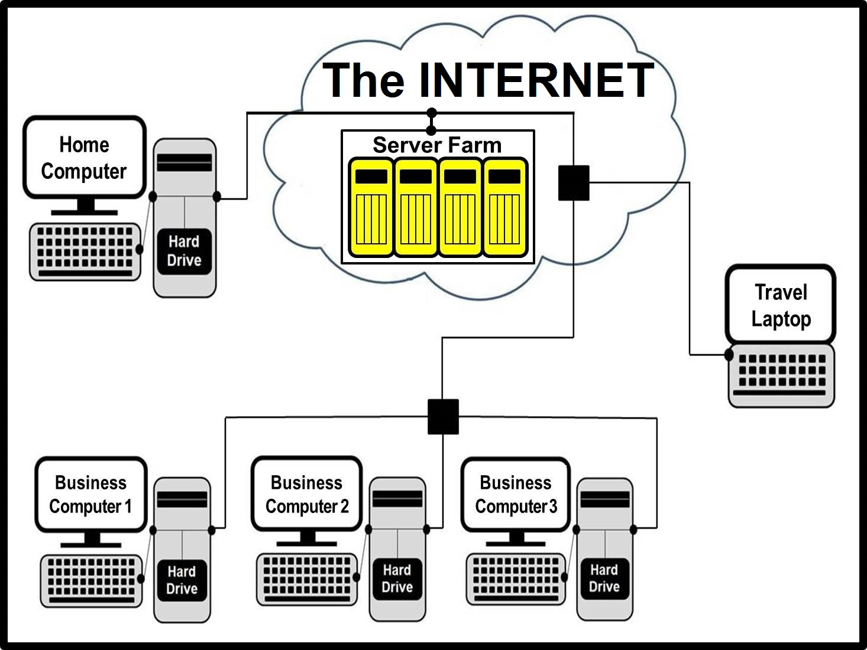
“The Cloud” is just a metaphor for “The Internet.”

Slide 17
The Department of Defense
The Internet has existed since the 1960s and has its origins in the "Cold War." During the Cold War there was a major concern about the country being paralyzed by a direct nuclear hit on the Pentagon.
A means of communication had
to be created that was capable
to keep working regardless of
damage created anywhere.
This was the birth of the Internet.
The Internet has no central
location where all the control
computers are located.
Any part of the Internet can be
damaged and all information will
then travel around the damaged area.
Many people confuse the
World Wide Web with the Internet.
The WWW invented by Tim Berners-Lee
in 1990 is PART of the Internet.

Slide 18
The Modern Internet
Normally, businesses and schools have a series of LANs that all connect into a large network called an Intranet.
An Intranet behaves like the Internet on a local business level.
This promotes security, speed and saves cost.
Now the moment you, your school, your business, or your home, connects to the outside world and giant world-wide network known as the Internet, you have access to millions of lines of telecommunications.
This will cost money and every person, every school, every business, who wants this access needs to use an Internet Service Provider or ISP.
You pay a monthly fee to the ISP for the Internet connection.
The amount of money you pay depends on the speed of your Internet connection.

